Slide 1

Conflict and View Serializability
Database Management System | Transaction Management and Scheduling
Course: Database Management System | Chapter: Transaction Management and Scheduling | Program: B.TECH-CSE, B.TECH CSE - CYBER SECURITY, B.TECH CSE - DATA
DISCOVER · LEARN · EMPOWER
Notes:
Welcome everyone to today's lecture on Conflict and View Serializability. We are diving deep into the core of Transaction Management. This topic is critical for ensuring data consistency when multiple users access the database simultaneously. Let's begin by understanding why serializability is the gold standard for concurrency control.

Slide 2
Course Outcomes
SLIDE 2 / 14
Course Outcome
CO | BT LEVEL | DESCRIPTION
CO1 | BT2 | Explain database architecture, relational model concepts and formal query language foundations including relational algebra and relational calculus.
CO2 | BT3 | Apply relational algebra, relational calculus and SQL constructs to formulate correct and efficient database queries.
CO3 | BT4 | Analyze functional dependencies and design normalized relational schemas up to 5NF ensuring lossless join and dependency preservation.
CO4 | BT4 | Analyze transaction schedules and concurrency control mechanisms to determine serializability, recoverability and correctness.
CO5 | BT5 | Evaluate storage structures, indexing strategies and query optimization techniques for performance, scalability and reliability.
Chandigarh University
2 / 14
Notes:
Today's session directly addresses our first two course outcomes. CO1 requires you to explain the foundational concepts of database architecture, which includes how transactions interact within the system. CO2 focuses on applying these concepts to formulate correct queries, ensuring that concurrent execution does not corrupt your data results.

Slide 3
Learning Objectives
SLIDE 3 / 14
Learning Outcomes
1
Define the concept of serializability in concurrent transaction processing.
2
Identify conflicting operations between two different transactions.
3
Distinguish between conflict serializability and view serializability.
4
Analyze schedules using precedence graphs for conflict detection.
5
Evaluate view equivalence through blind writes and read sets.
Chandigarh University
3 / 14
Notes:
By the end of this lecture, you will be able to define serializability and identify conflicting operations. You will learn to distinguish between conflict and view serializability, which are the two main types of equivalence. We will also analyze schedules using precedence graphs to determine if a schedule is safe to execute.

Slide 4
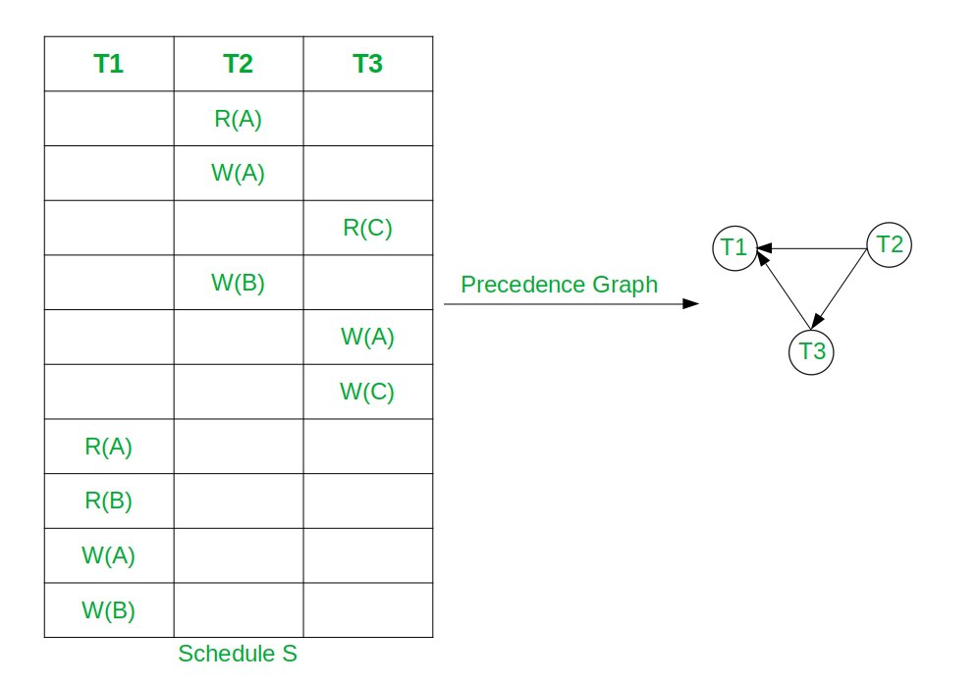
Lecture
SLIDE 4 / 14
Serializability Definition
1
A schedule is serializable if it is equivalent to some serial schedule.
2
Serial schedules execute transactions one after another without interleaving.
3
Concurrent schedules improve performance but risk data inconsistency.
4
Serializability ensures the final database state matches a serial execution.
5
It is the primary criterion for correctness in concurrency control.
6
Two schedules are equivalent if they produce the same final state.
Equivalent Serial Schedule of Conflict Serializable Schedule in DBMS - GeeksforGeeks
Chandigarh University
4 / 14
Notes:
Serializability is the gold standard for correctness. A schedule is serializable if it produces the same final database state as some serial schedule. While serial schedules are safe, they are slow. Concurrent schedules are faster but must be checked to ensure they do not violate data integrity.

Slide 5
Lecture
SLIDE 5 / 14
Conflict Operations
1
Two operations conflict if they access the same data item.
2
At least one operation must be a write operation to conflict.
3
Operations must belong to different transactions to be conflicting.
4
Read-Read operations never conflict as they do not modify data.
5
Read-Write and Write-Read operations create dependency chains.
6
Write-Write operations create a dependency on the final value.
Chandigarh University
5 / 14
Notes:
Conflicts arise when two operations from different transactions access the same data item. Crucially, at least one of these operations must be a write. If both are reads, they do not conflict because reading does not change the data. This distinction is vital for building precedence graphs.

Slide 6
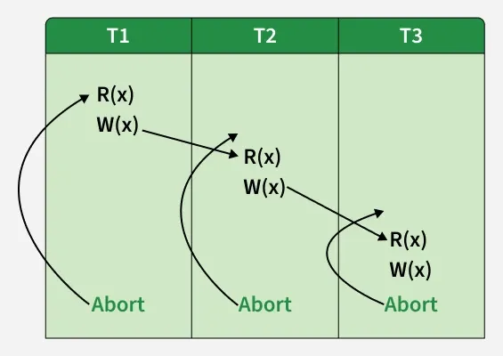
Lecture
SLIDE 6 / 14
Conflict Serializability
1
A schedule is conflict serializable if it can be transformed into a serial one.
2
Transformation involves swapping non-conflicting adjacent operations.
3
Swapping non-conflicting operations does not change the final outcome.
4
If a schedule is conflict serializable, it is also view serializable.
5
Conflict serializability is a sufficient condition for view serializability.
6
It is the most commonly used test for schedule correctness.
Source: media.geeksforgeeks.org
Chandigarh University
6 / 14
Notes:
Conflict serializability allows us to transform a concurrent schedule into a serial one by swapping non-conflicting operations. If we can swap operations until all transactions are contiguous, the schedule is conflict serializable. This is a strong condition and is widely used because it is easy to test.

Slide 7
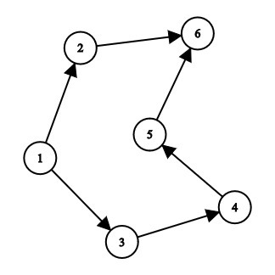
Lecture
SLIDE 7 / 14
Precedence Graph Method
1
Construct a directed graph where nodes represent transactions.
2
Draw an edge from Ti to Tj if Ti conflicts with Tj.
3
An edge exists if Ti's operation precedes Tj's conflicting operation.
4
The graph must be acyclic for the schedule to be serializable.
5
A cycle in the graph indicates a non-serializable schedule.
6
Topological sorting of the graph yields an equivalent serial order.
Source: media.geeksforgeeks.org
Chandigarh University
7 / 14
Notes:
To test for conflict serializability, we build a precedence graph. Each node represents a transaction, and edges represent conflicts. If the graph contains a cycle, the schedule is not serializable. If the graph is acyclic, we can perform a topological sort to find the equivalent serial order.

Slide 8
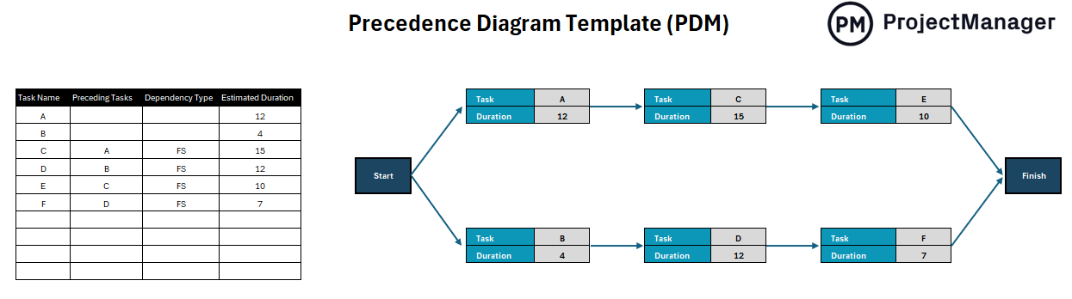
Worked Example
SLIDE 8 / 14
Conflict
SCHEDULE S
T1: R(A), W(A), T2: R(A), W(A).
• T1 reads A before T2 reads A, creating a dependency.
• T1 writes A before T2 writes A, creating a dependency.
• Graph has edge T1 → T2 due to R(A) and W(A) conflicts.
• No cycle exists in the precedence graph.
• Schedule S is conflict serializable with order T1 → T2.
Source: www.projectmanager.com
Chandigarh University
8 / 14
Notes:
Let's look at a concrete example. T1 reads and writes A, then T2 reads and writes A. T1 must precede T2 because T1's operations happen first. The graph shows a single edge from T1 to T2. Since there is no cycle, this schedule is conflict serializable.

Slide 9
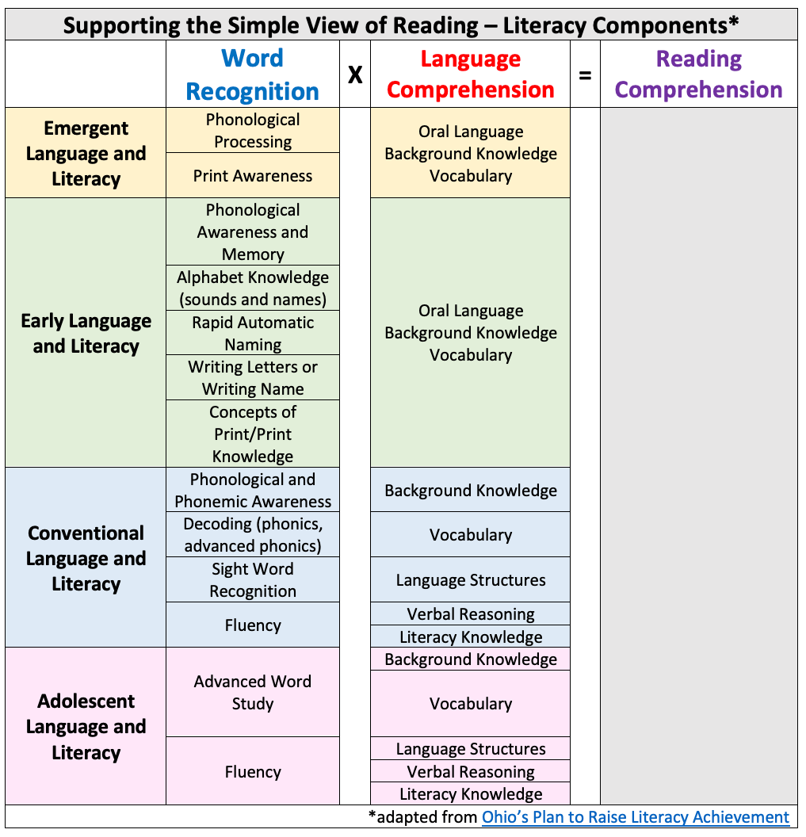
Lecture
SLIDE 9 / 14
View Serializability
1
View serializability is a weaker condition than conflict serializability.
2
Two schedules are view equivalent if they have same read/write sets.
3
Initial reads must read the same initial values in both schedules.
4
Final writes must write the same final values in both schedules.
5
Intermediate reads must read from the same write operations.
6
A schedule is view serializable if it is view equivalent to a serial one.
Source: i0.wp.com
Chandigarh University
9 / 14
Notes:
View serializability is a broader concept. Two schedules are view equivalent if they produce the same reads and writes. This includes initial reads, intermediate reads, and final writes. A schedule is view serializable if it matches a serial schedule in these specific aspects.

Slide 10
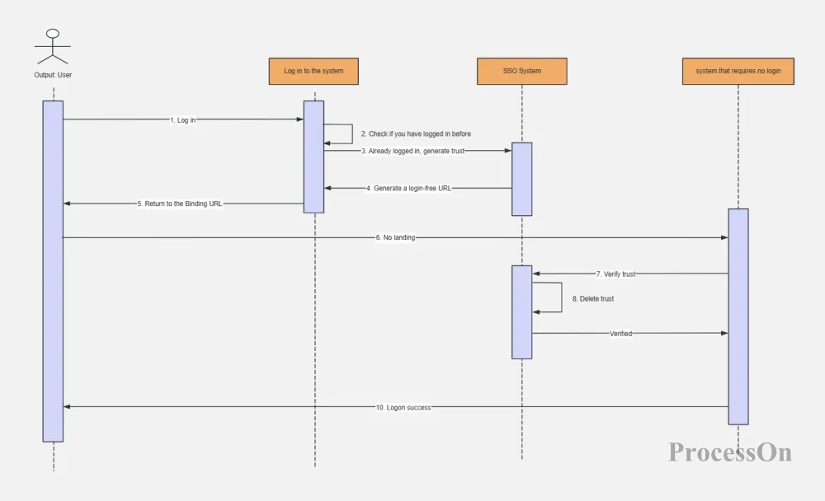
Lecture
SLIDE 10 / 14
Blind Writes Concept
1
A blind write occurs when a transaction writes a value without reading it.
2
Blind writes can create view equivalence without conflict equivalence.
3
Conflict serializability cannot detect schedules with blind writes.
4
View serializability handles blind writes through read equivalence checks.
5
This makes view serializability a more general correctness criterion.
6
Schedules with blind writes may be view serializable but not conflict serializable.
Source: cdn.processon.io
Chandigarh University
10 / 14
Notes:
Blind writes are writes that do not read the data item first. These operations can create view equivalence even when there are no conflicts. This means a schedule might be view serializable but not conflict serializable. This is a key distinction in advanced concurrency control.

Slide 11
Worked Example
SLIDE 11 / 14
View
SCHEDULE S
T1: W(A), T2: R(A), W(A).
• T2 reads A written by T1, creating a dependency.
• T2 writes A, overwriting T1's value.
• Graph has edge T1 → T2 due to R(A) dependency.
• No cycle exists in the precedence graph.
• Schedule S is view serializable with order T1 → T2.
Chandigarh University
11 / 14
Notes:
Consider a schedule where T1 writes A, then T2 reads and writes A. T2 reads the value written by T1. This creates a dependency. The graph shows T1 must precede T2. Since there is no cycle, this schedule is view serializable.

Slide 12
Lecture
SLIDE 12 / 14
Common Pitfalls
1
Assuming all view serializable schedules are conflict serializable.
2
Ignoring blind writes when constructing precedence graphs.
3
Confusing read-read operations with conflicting operations.
4
Failing to check for cycles in the precedence graph.
5
Overlooking the initial read equivalence in view serializability.
6
Assuming serializability guarantees isolation without proper locking.
Chandigarh University
12 / 14
Notes:
Students often make the mistake of assuming all view serializable schedules are conflict serializable. This is false due to blind writes. Another common error is ignoring blind writes when building graphs. Always check for cycles and ensure initial reads match in view serializability.

Slide 13
Lecture
SLIDE 13 / 14
Key Takeaways
1
Serializability ensures concurrent schedules match serial execution outcomes.
2
Conflict serializability relies on swapping non-conflicting operations.
3
Precedence graphs must be acyclic for conflict serializability.
4
View serializability includes blind writes and is a weaker condition.
5
Blind writes allow view serializability without conflict serializability.
Chandigarh University
13 / 14
Notes:
To summarize, serializability ensures data consistency. Conflict serializability is tested using precedence graphs and requires no cycles. View serializability is broader and includes blind writes. Remember that blind writes can make a schedule view serializable even if it is not conflict serializable.

Slide 14
Lecture
SLIDE 14 / 14
References
1
Fundamentals of Database Systems — Ramez Elmasri & Shamkant B. Navathe
2
Database System Concepts — Silberschatz, Korth & Sudarshan
3
Database Management Systems — Raghu Ramakrishnan & Johannes Gehrke
4
Oracle/MySQL Documentation — Oracle
Chandigarh University
14 / 14
Notes:
For further reading, please refer to the standard textbooks listed here. Elmasri and Navathe provide excellent coverage of transaction management. Silberschatz and Ramakrishnan also offer deep insights into serializability and concurrency control. These resources will help you master the concepts discussed today.

